Slide 1
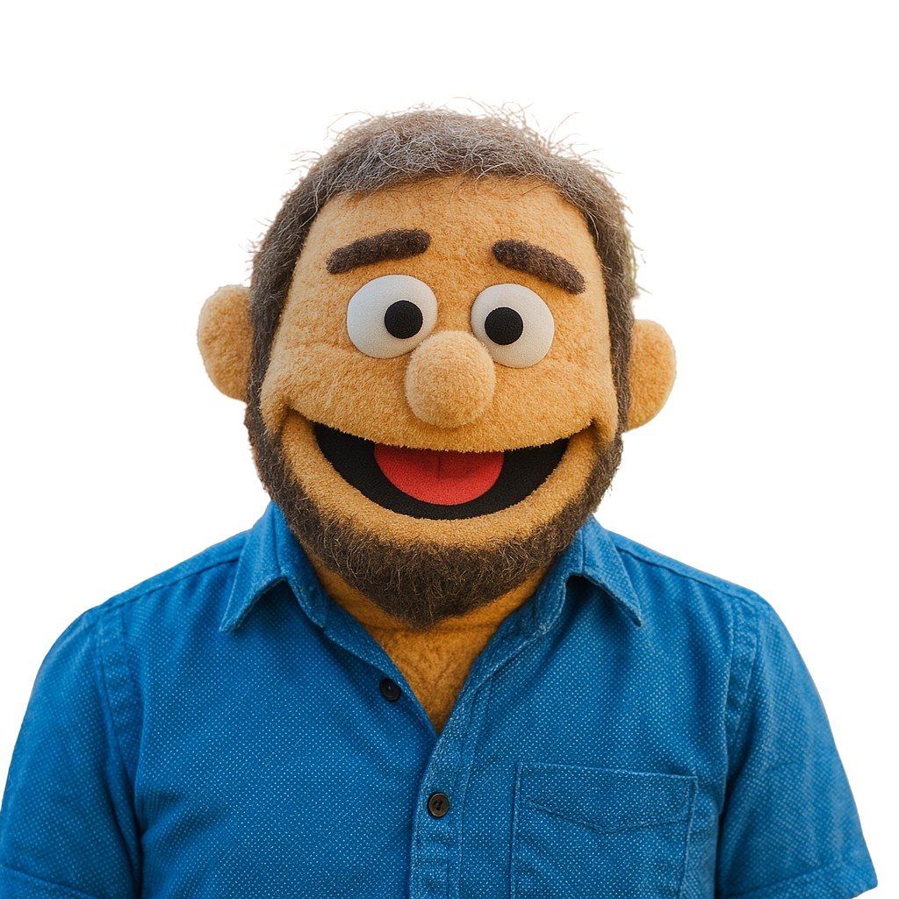

Empower Autistic Students with Innovative Technologies
Craig Smith

Slide 2

I am interested in how we can think
differently about
how we teach
autistic students.
I want to focus on the strengths of our students and use technology to empower them.

Slide 3
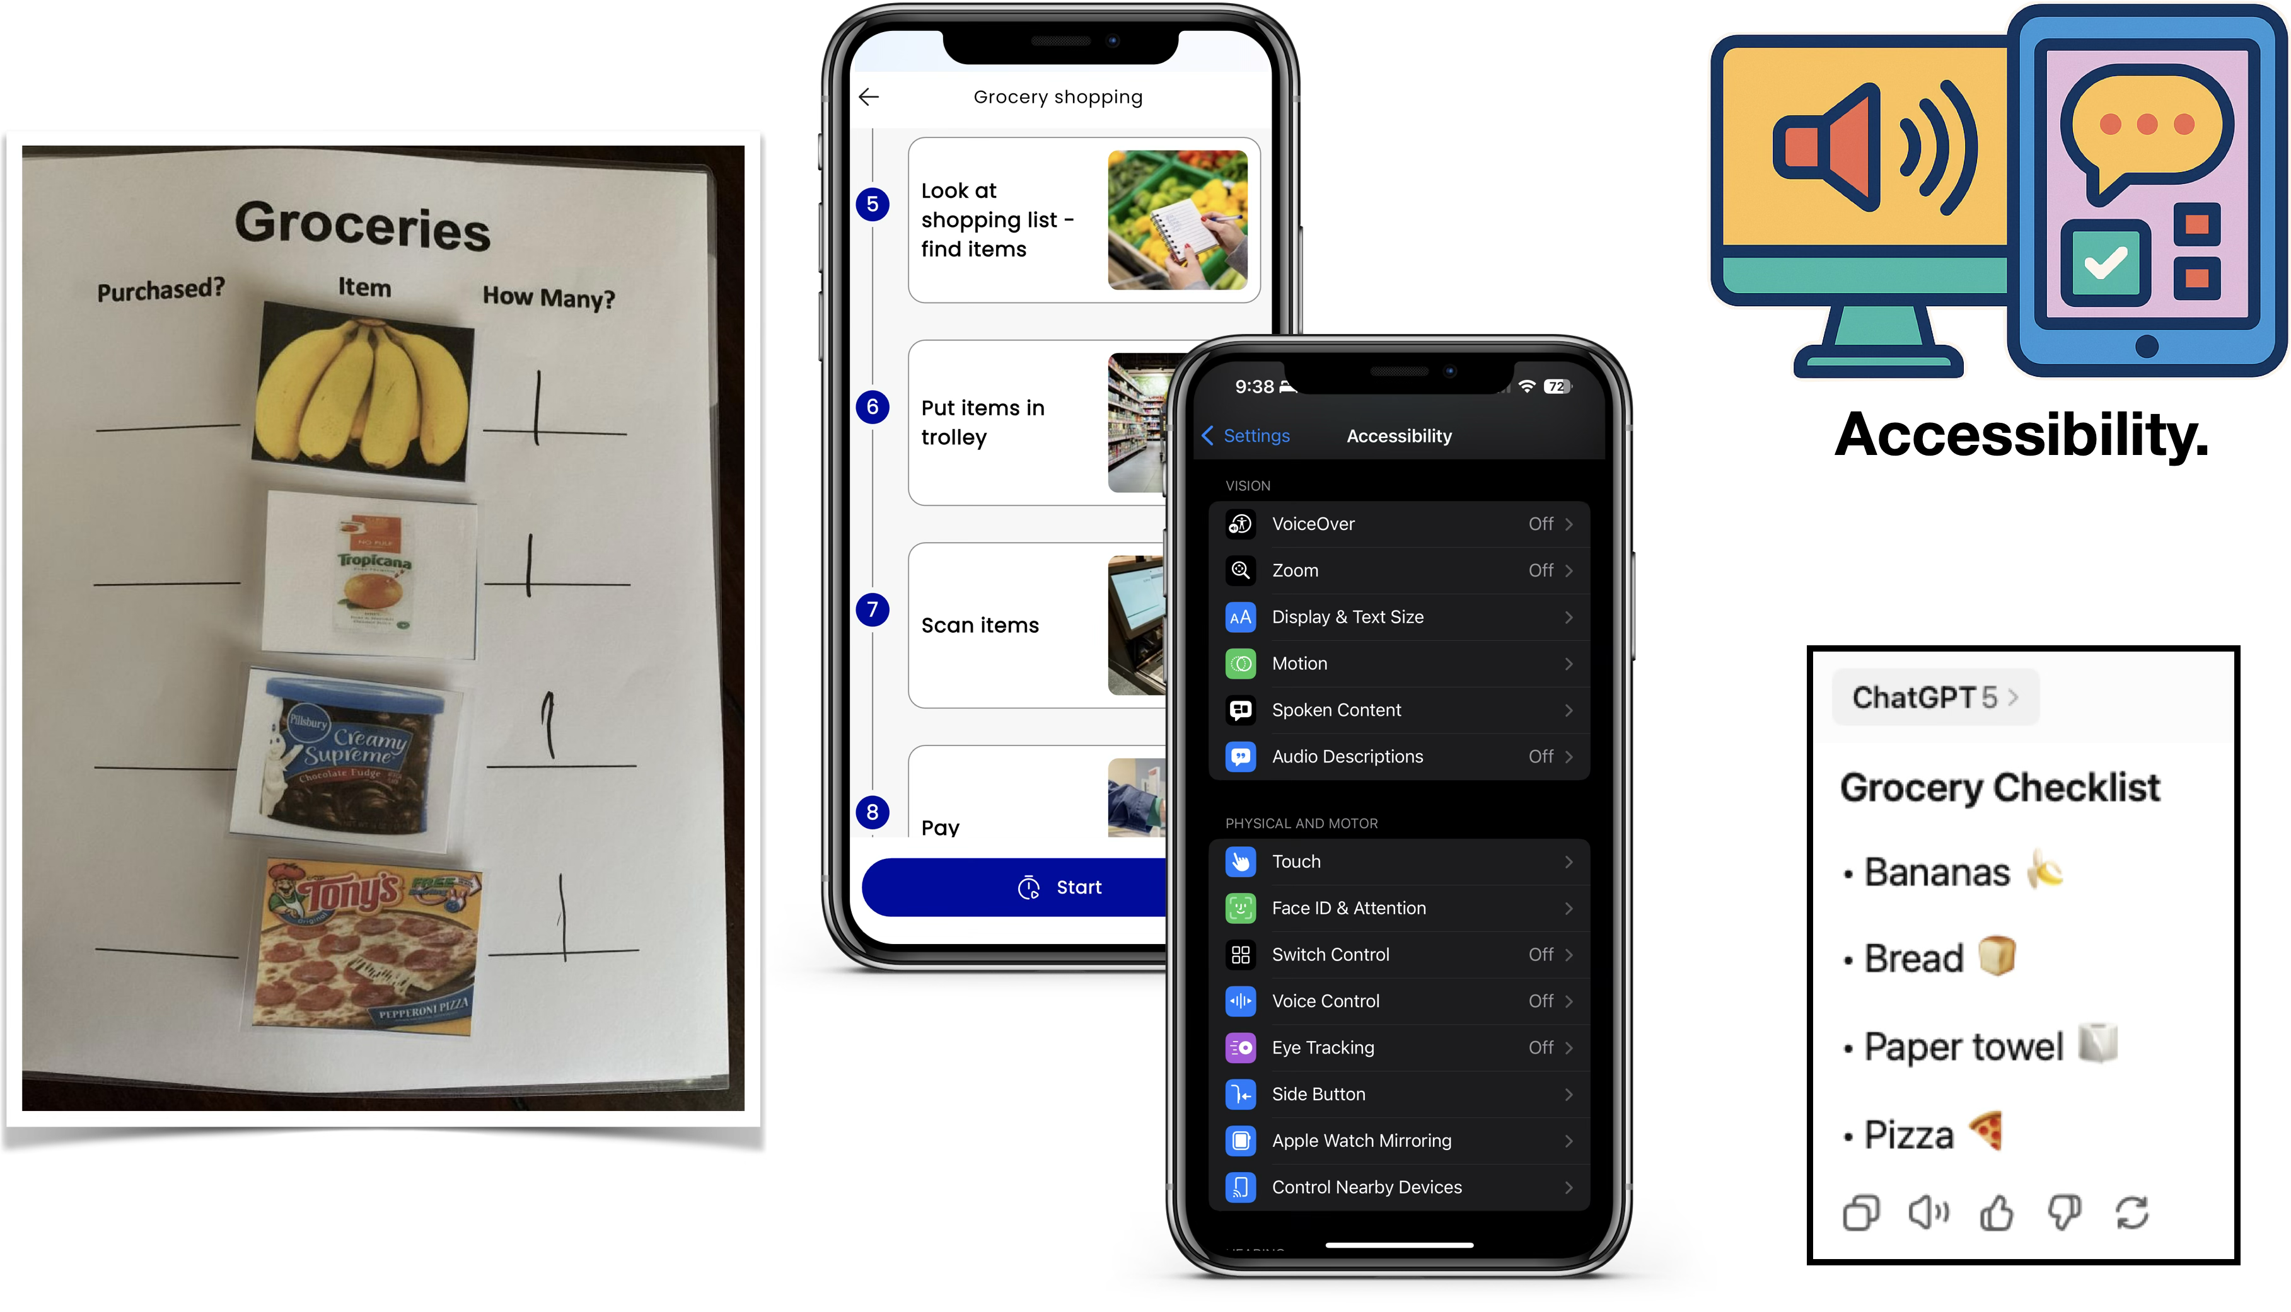
Some of the most important ways we teach autistic students – through visual supports, with executive functioning guidance – continue to evolve as technologies develop and expand.

Slide 4


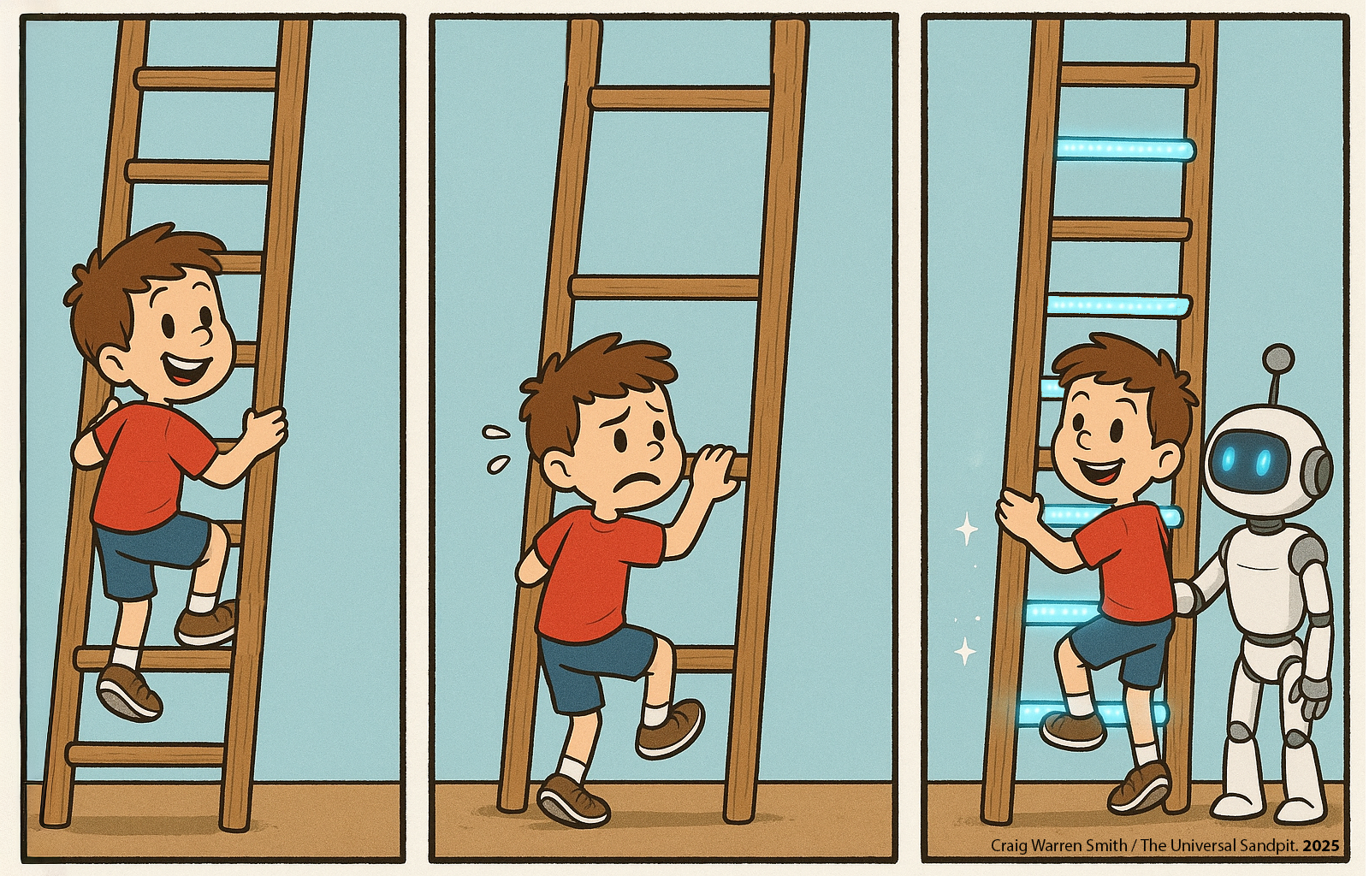
The first panel shows a child climbing a ladder that is well designed for them.
The second panel shows a child having trouble climbing a ladder that is not designed for them.
The third panel shows how technology might be able to fill in the design gaps.
This is how I think technology can support gaps in our learning environments: if our children are in classrooms that are not always catering to their specific needs, it may be that technology can help with inclusive outcomes.

Slide 5
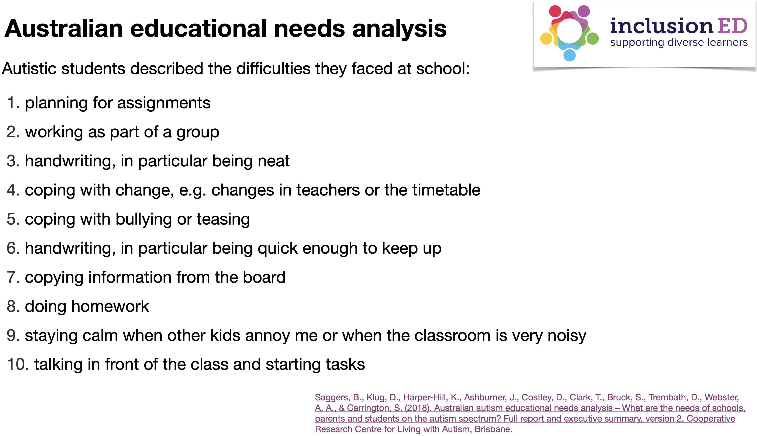

Slide 6
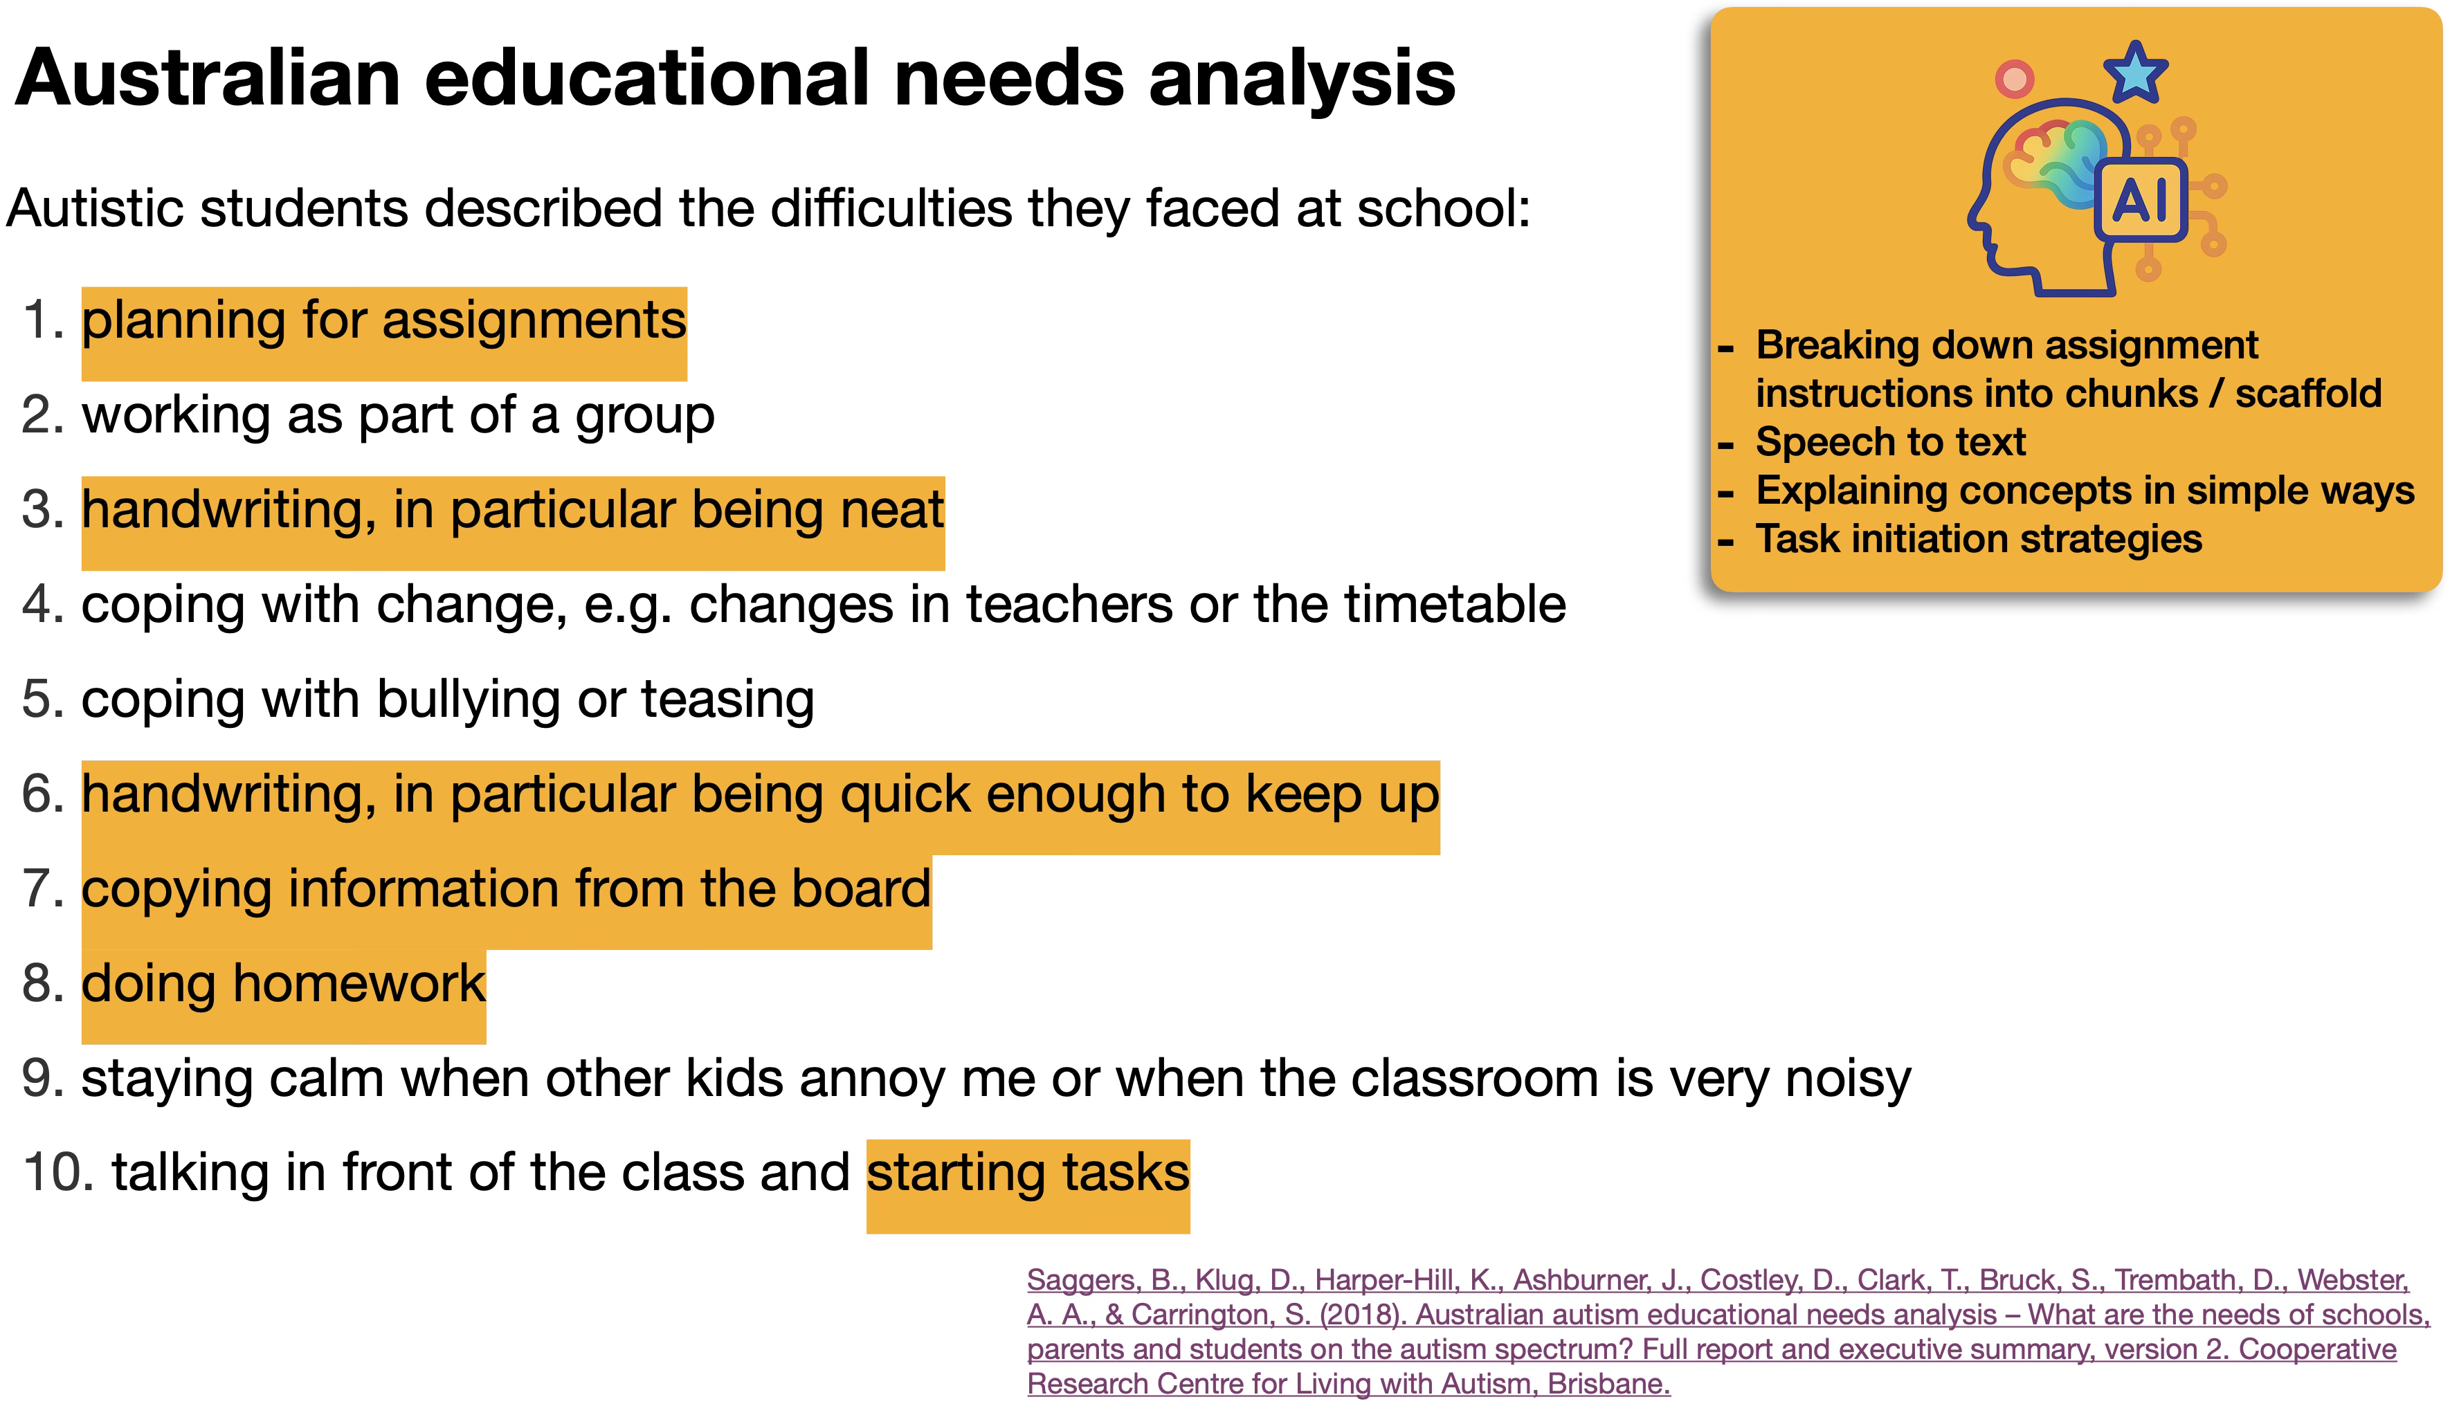

Slide 7

The Universal Sandpit
AI Tools for Inclusive Schools
For Teachers:
Strengths and Interests
Task Analysis
Reflective Lens
For Students:
Floating Thoughts
Student Multi-Tool
Pathway
www.theuniversalsandpit.org

Slide 8
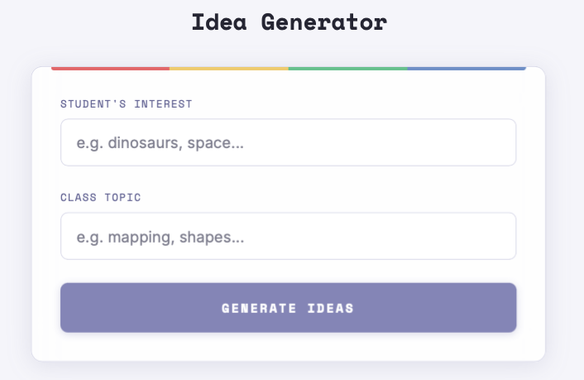
Strengths and Interests.
This tool lets you enter an interest that a student has, and the topic being taught in class.
Then, the tool will provide you with ten ways to authentically integrate the interest of the student into the curriculum.
You can then tap on an idea and the tool will provide you with further guidance about how to teach a lesson by including what the student is interested in.

Slide 9
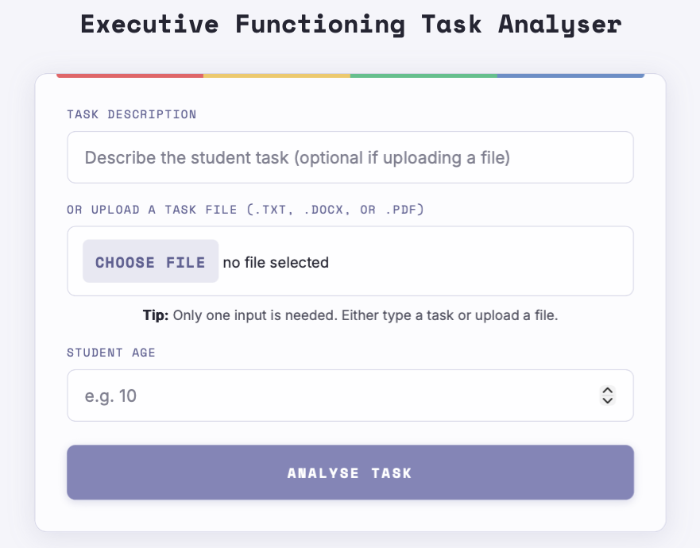
Executive Functioning Task Analyser.
Executive functioning can be one of the hardest things to plan for, but it makes a big difference for student success.
This tool will analyse a task you are teaching in class and will provide you with practical guidance across key executive functioning domains to help your planning and lesson design.

Slide 10
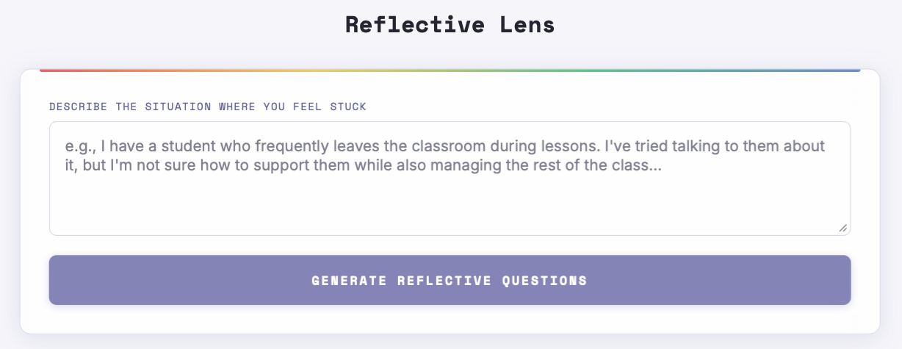
Reflective Lens.
This tool is useful for when you are ‘feeling stuck’ with a student, not knowing what to do next to best support them. You enter the current situation and the tool will generate questions to help you plan what to do next. The questions focus on the classroom environment and use ‘neurodiversity-affirming’ prompts, from a student’s perspective.

Slide 11
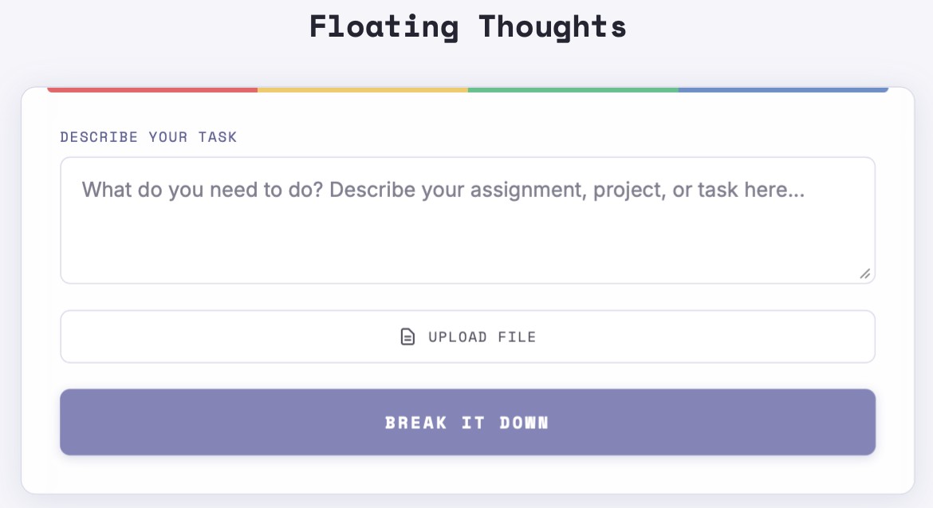
Floating Thoughts.
This tool is for students. It helps break down big tasks in smaller, manageable chunks.
Students describe a project they need to complete (or they can upload it) and the tool will help split the task into steps that students can organise in whatever order makes sense to them.

Slide 12
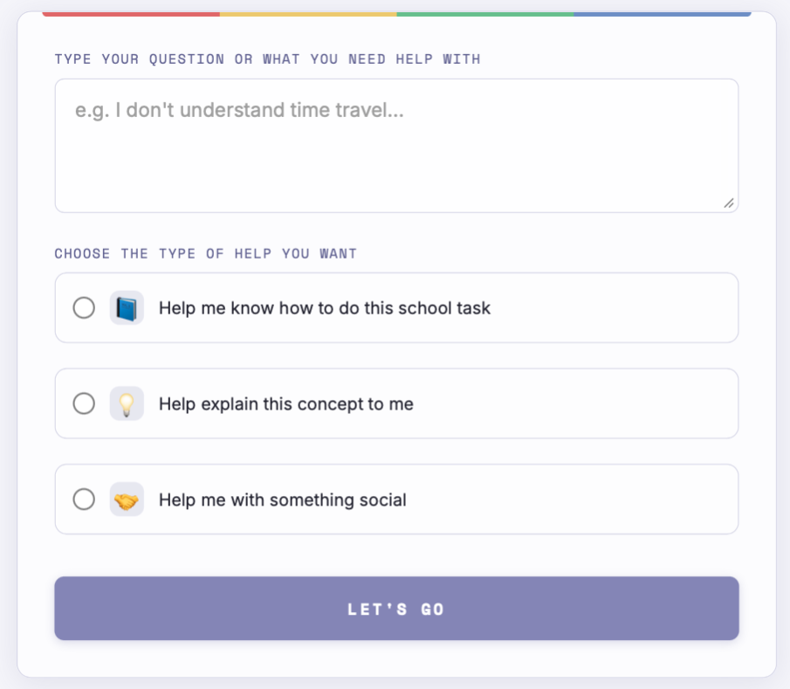
Student Multi-Tool.
Students can use this tool to do three different things:
It will help them understand how to complete a school task;
It will help explain a concept to them in a simpler way;
It will help them understand a social situation that may be confusing or uncertain.

Slide 13
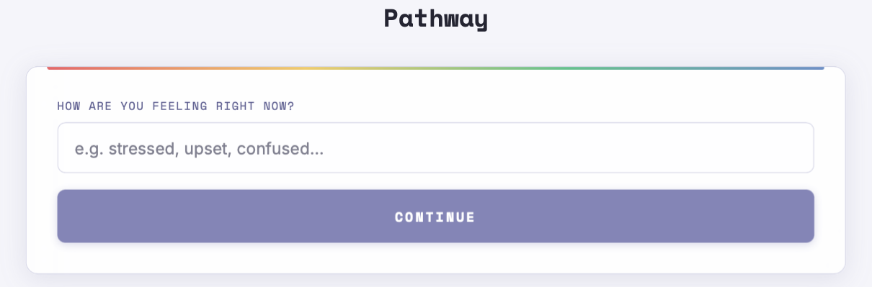
Pathway.
This tool helps students to understand how they are feeling, and will give them strategies to help them feel something different. Students type in how they are feeling now, and then how they want to feel. The tool will then give four self-regulation strategies to help them on this emotional pathway.

Slide 14

Beyond chatbots -
AI interactions with the world around us

Slide 15

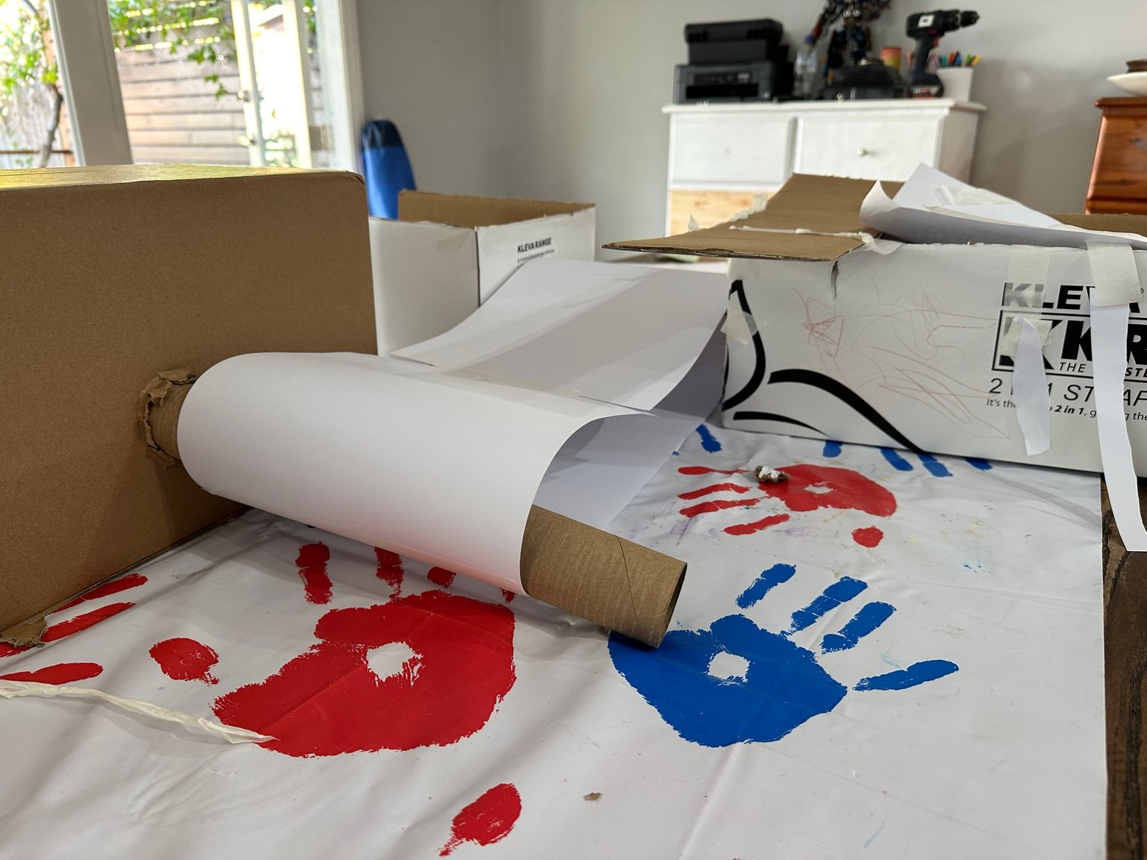
Problem Solving.
I’m interested in the ways that technology can help us with real-world problems.
I was trying to build a conveyor belt from cardboard, for a project, and I only had a few resources with me. I couldn’t get the conveyor belt to work.
Then, I pointed an AI tool at what I had built, and told it the resources I had, and it helped me finish building the project successfully.

Slide 16

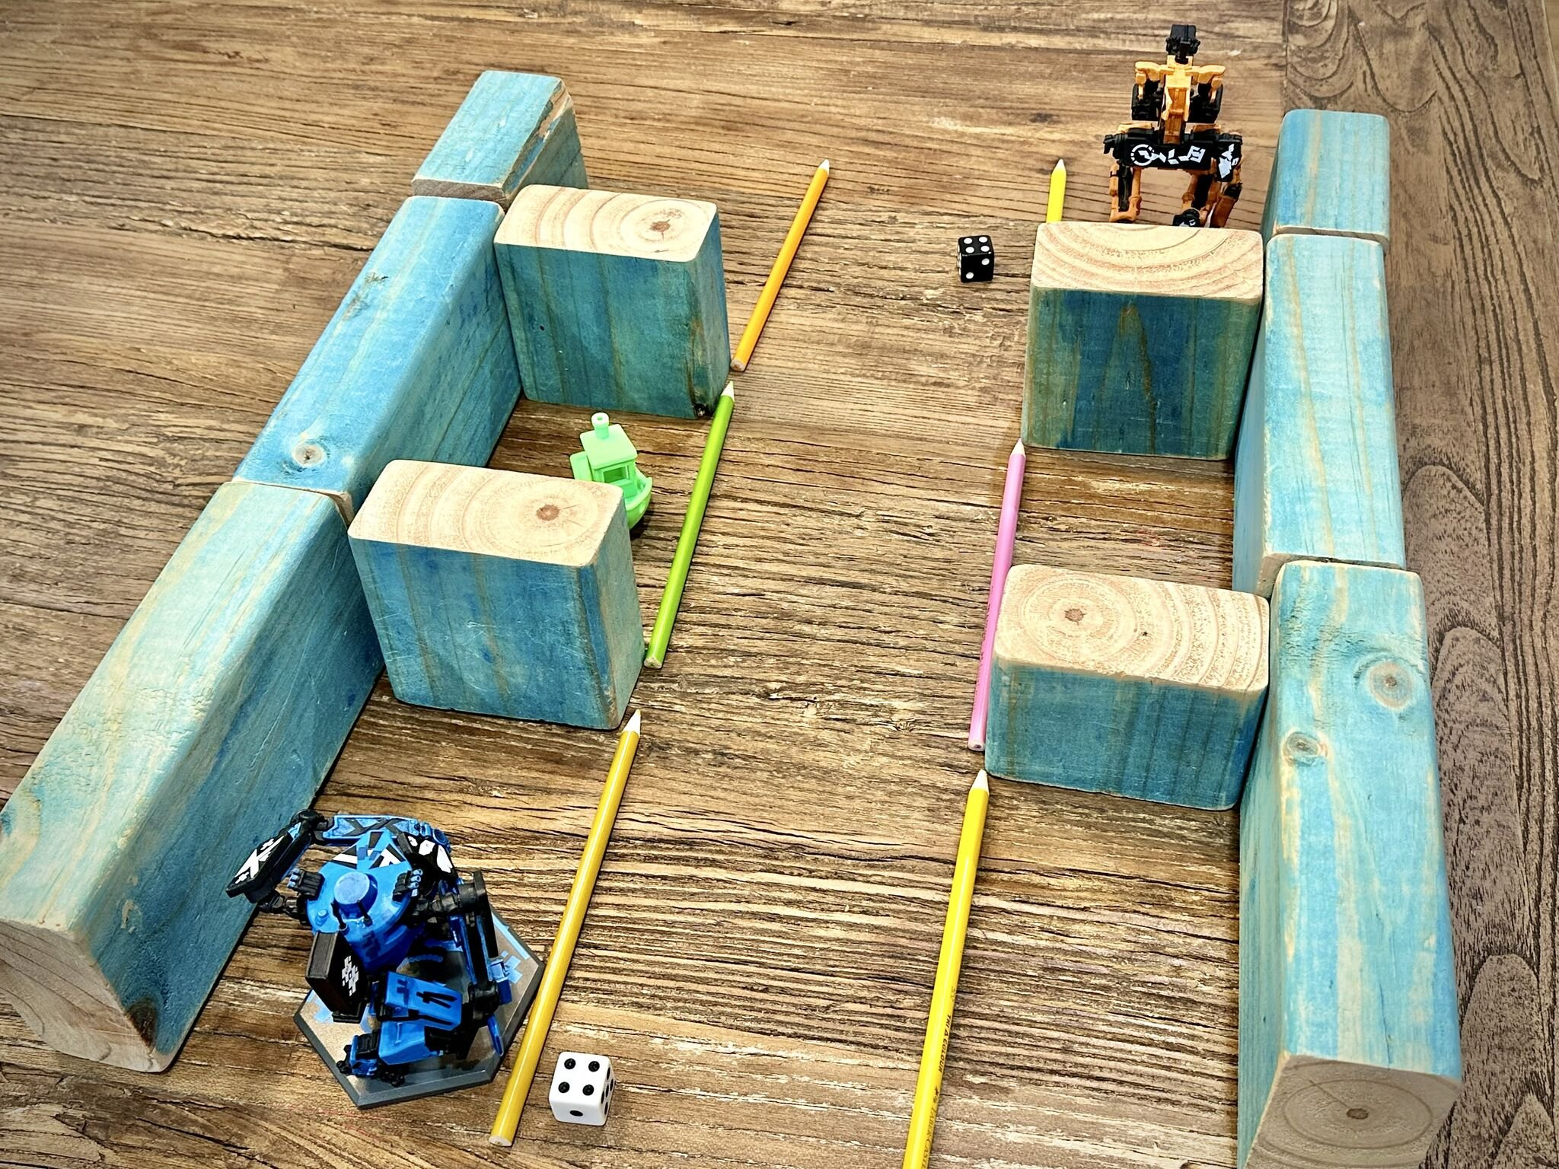
Creating Activities.
I was in a classroom where we didn’t have all the resources needed to play a game.
Using an AI tool, I took a photo of the resources we had available.
The tool then created a game for us, using the resources we had, allowing the students to play a new game. The students then added their own ideas in, creating a game that they all loved playing together.

Slide 17
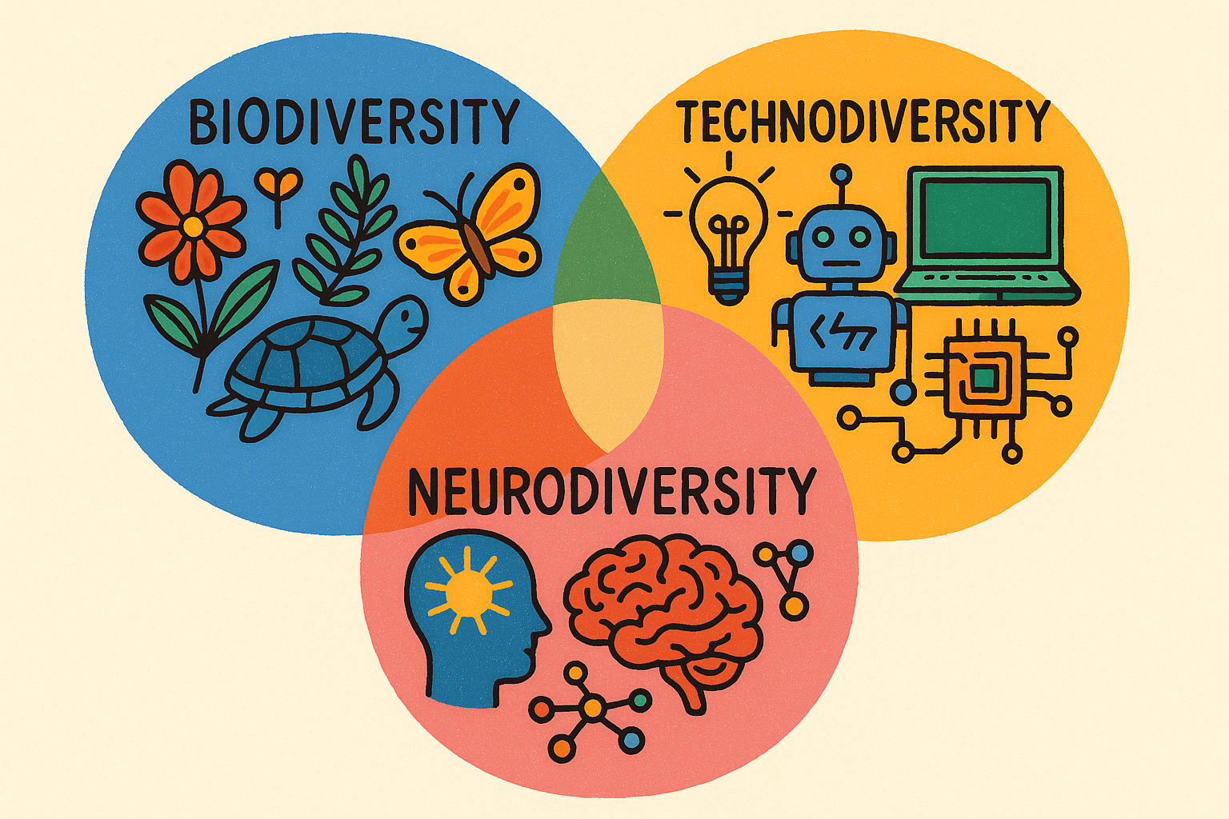
We best support our students when we recognise the diversity of each of them and provide technologies that are diverse and allow for personalisation unique to the needs of every individual student.

Slide 18



The Universal Sandpit
AI Tools for Inclusive Schools
Thank you
theuniversalsandpit.org
Universal Sandpit:
Quarterly SubStack Journal
theuniversalsandpit.substack.com
www.linkedin.com/in/craig-warren-smith/

